Slide 1
CSIT988/CSIT488
Security, Ethics and Professionalism
Week 1: Introduction and Overview of the Subject
Lecturer: Guangyou Zhou
School of Computer, Central China Normal University
Spring 2024

Slide 2
What Is Security?
Definitions
  Security is defined as “the quality or state of being secure—to be free from danger”
  Security is often achieved by means of several strategies undertaken simultaneously or used in combination with one another
Specialized areas of security
  Physical security, operations security, communications security, and network security
Notes:
1. Physical security—Protecting people, physical assets, and the workplace from various threats, including fire, unauthorized access, and natural disasters
2. Operations security—Protecting the organization’s ability to carry out its operational activities without interruption or compromise
3. Communications security—Protecting the organization’s communications media, tech- nology, and content, and its ability to use these tools to achieve the organization’s objectives
4. Network security—Protecting the organization’s data networking devices, connections, and contents as well as protecting the ability to use that network to accomplish the organization’s data communication functions

Slide 3
What Is Security?
Physical security
  Protecting people, physical assets, and the workplace from various threats, including fire, unauthorized access, and natural disasters
Operations security
  Protecting the organization’s ability to carry out its operational activities without interruption or compromise
Communications security
  Protecting the organization’s communications media, technology, and content, and its ability to use these tools to achieve the organization’s objectives
Network security
  Protecting the organization’s data networking devices, connections, and contents as well as protecting the ability to use that network to accomplish the organization’s data communication functions
Notes:
1. Physical security—Protecting people, physical assets, and the workplace from various threats, including fire, unauthorized access, and natural disasters
2. Operations security—Protecting the organization’s ability to carry out its operational activities without interruption or compromise
3. Communications security—Protecting the organization’s communications media, tech- nology, and content, and its ability to use these tools to achieve the organization’s objectives
4. Network security—Protecting the organization’s data networking devices, connections, and contents as well as protecting the ability to use that network to accomplish the organization’s data communication functions

Slide 4
What Is Security? (cont’d.)
Information security
  The protection of information and its critical elements (confidentiality, integrity and availability), including the systems and hardware that use, store, and transmit that information
    Through the application of policy, technology, and training and awareness programs
Policy, training and awareness programs and technology are vital concepts
Management of Information Security, 3rd Edition

Slide 5
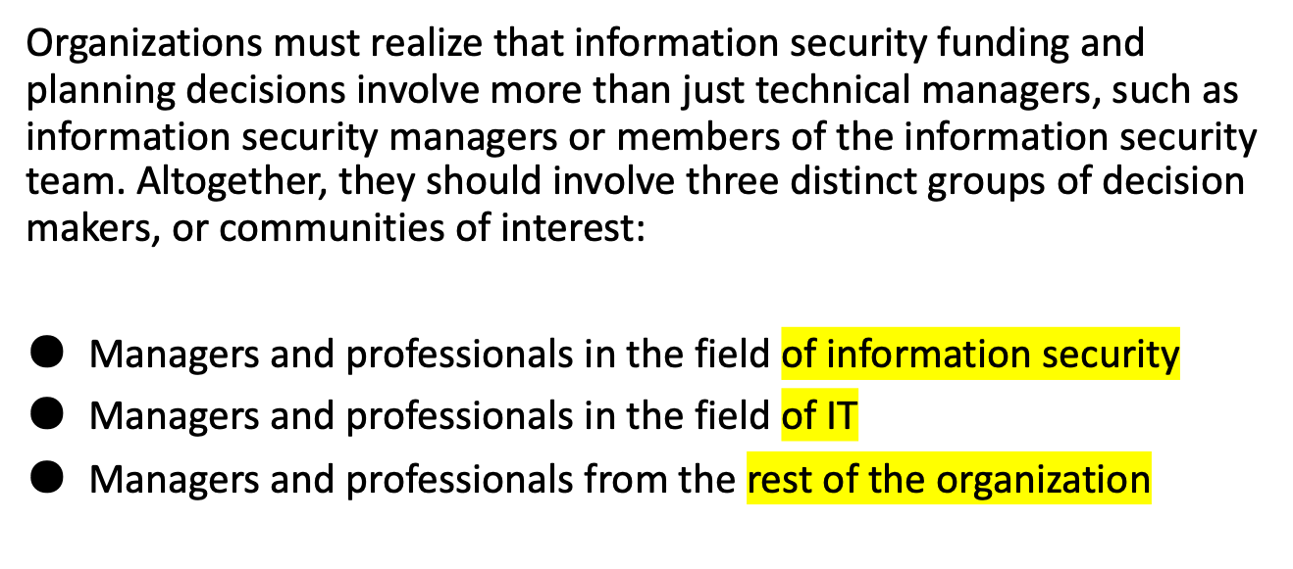
Communities of Interest
Notes:
1. Physical security—Protecting people, physical assets, and the workplace from various threats, including fire, unauthorized access, and natural disasters
2. Operations security—Protecting the organization’s ability to carry out its operational activities without interruption or compromise
3. Communications security—Protecting the organization’s communications media, tech- nology, and content, and its ability to use these tools to achieve the organization’s objectives
4. Network security—Protecting the organization’s data networking devices, connections, and contents as well as protecting the ability to use that network to accomplish the organization’s data communication functions

Slide 6
Communities of Interest
The information security community protects the organization’s information assets from the many threats they face.
The information technology community supports the business objectives of the organization by supplying and supporting IT that is appropriate to the organization’s needs.
The general business community articulates and communicates organizational policy and objectives and allocates resources to the other groups.
Notes:
1. Physical security—Protecting people, physical assets, and the workplace from various threats, including fire, unauthorized access, and natural disasters
2. Operations security—Protecting the organization’s ability to carry out its operational activities without interruption or compromise
3. Communications security—Protecting the organization’s communications media, tech- nology, and content, and its ability to use these tools to achieve the organization’s objectives
4. Network security—Protecting the organization’s data networking devices, connections, and contents as well as protecting the ability to use that network to accomplish the organization’s data communication functions

Slide 7
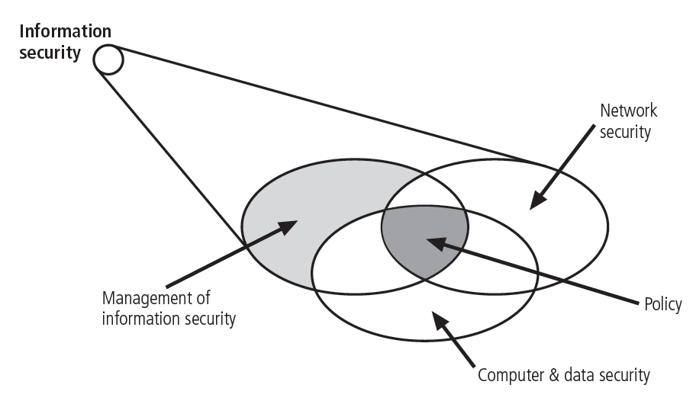
Components of Information Security
Figure 1-1 Components of Information security

Slide 8
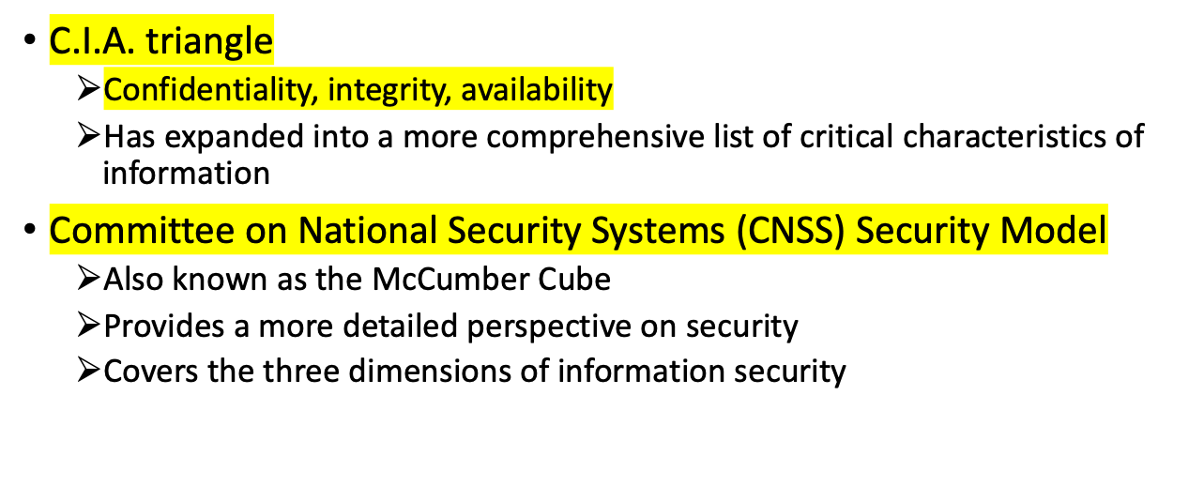
CNSS Security Model

Slide 9
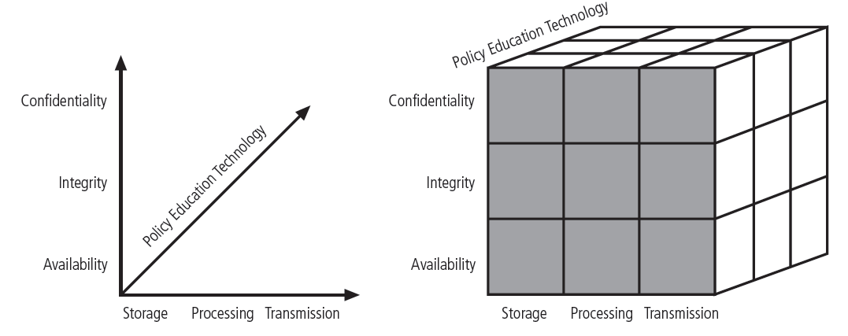
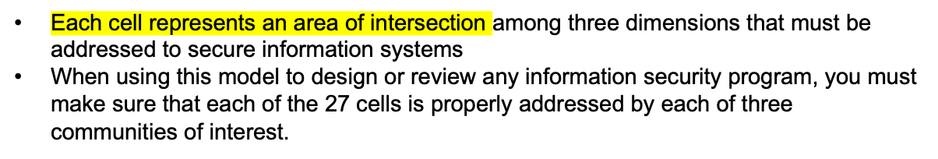
CNSS Security Model (cont’d.)
Figure 1-2 CNSS security Model

Slide 10
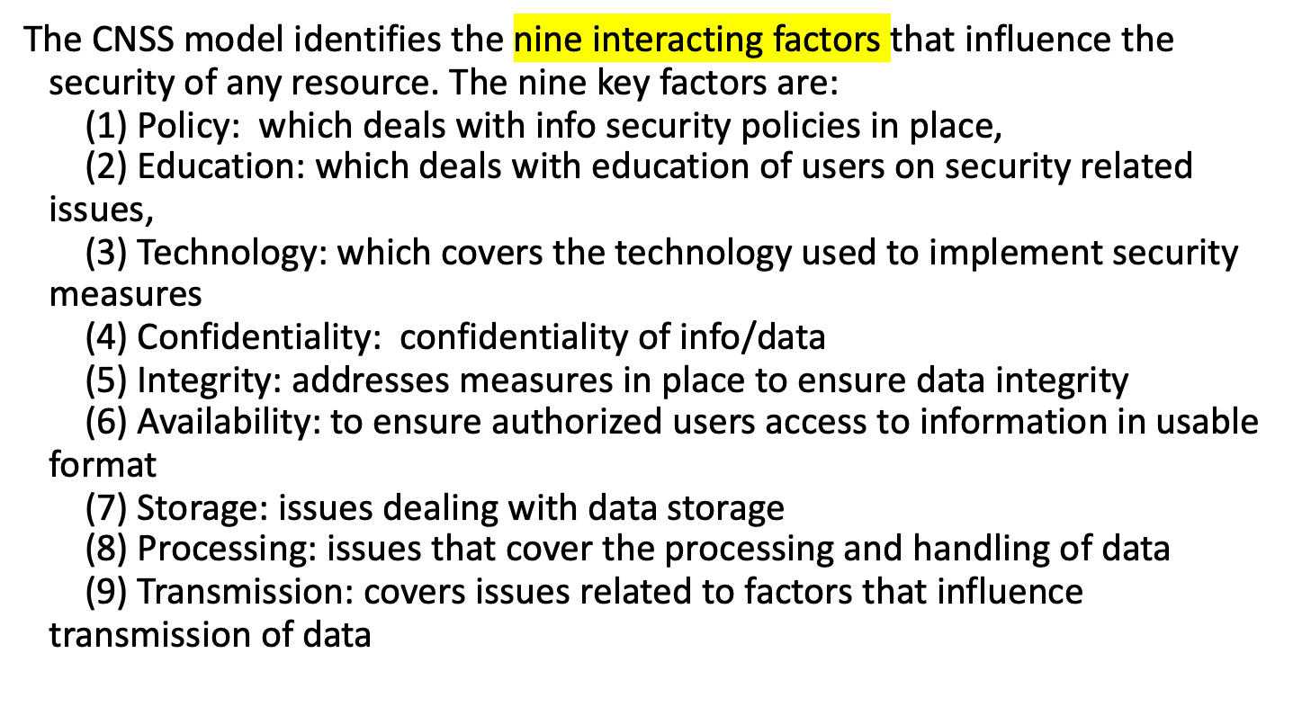
CNSS Security Model (cont’d.)

Slide 11
CNSS Security Model (cont’d.)
To apply the model, examine the intersecting cells on the CNSS cube and determine how you could address some of the factors influencing security of class information.
Some examples that you may consider are:
First you could consider the nine factors individually. For example,
Confidentiality: Only students registered in the course have access to the course web page.
Integrity: Students would have unit logins which would be their means to access the course webpage via eCollege. Students can only alter or modify their own work, and cannot change or delete another student's submitted work.

Slide 12
(3) Availability: The university would ensure that the eCollege site is accessible to all online students with minimal downtime for maintenance and upgrades.
After you have addressed the individual factors, you can address the intersecting cells in the CNSS security model. Some examples include:
Confidentiality/Policy/Storage - This cell represents the intersection of the factors Data Confidentiality, Security Policy, and Data Storage. This can be addressed by adopting the following policy:-- "Only students registered in the course are able to access course related material and student discussion posts. Additionally, homework assignments are only viewable by the instructor and the applicable student"

Slide 13
Integrity/Policy/Processing -
formed by the intersection of the Integrity, Policy, and Processing cells.
This can be addressed by having a policy such as:-- "The course would
have a policy that would all work submitted by the students must
represent their own work, and would properly cite all sources referenced."

Slide 14
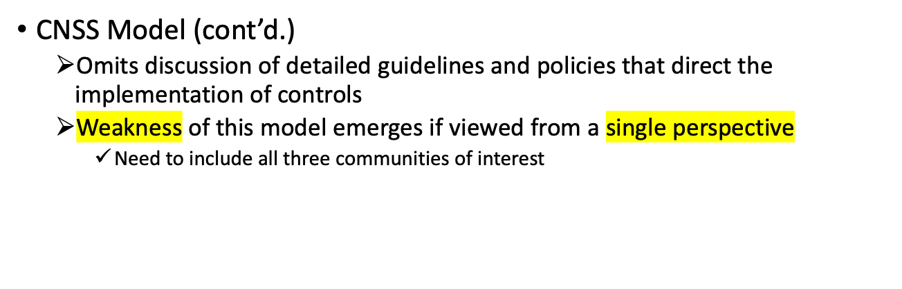
CNSS Security Model (cont’d.)

Slide 15
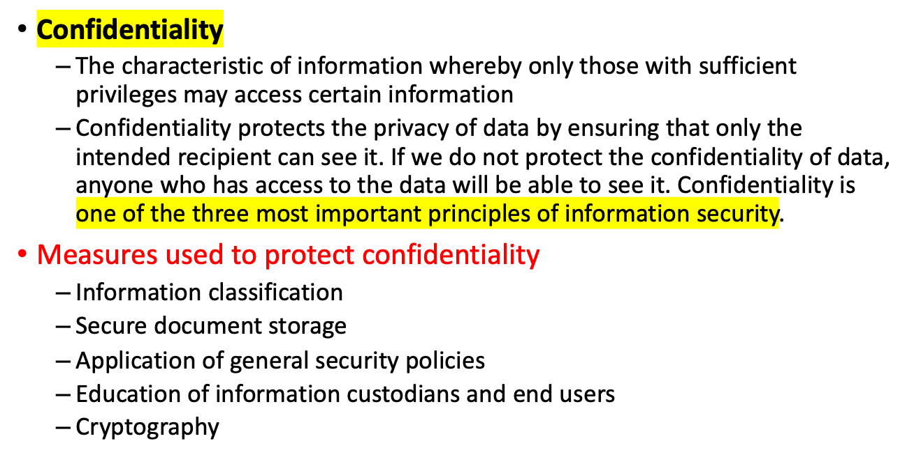
Key Concepts of Information Security

Slide 16
Key Concepts of Information Security (cont’d.)
Integrity
  The quality or state of being whole, complete, and uncorrupted
  Integrity ensures that data cannot be modified without being detected. If we do not ensure the integrity of data, then it can be modified without our knowledge. So as a result, we may end up using corrupted data. Which can damage our systems and cause us to lose information.
  For example, if we change a file without being aware that we are doing this. Then the data in the file will become corrupted.
  When it happens, if someone modifies a file on our computer. Especially while we are working on it. We might not be aware that the file is changed. It is because we would only be looking at the file that we are working on. We would probably not even notice that the file is modified. In this case, the integrity of the data is compromised.

Slide 17
Key Concepts of Information Security (cont’d.)
Availability
  The characteristic of information that enables user access to information in a required format, without interference or obstruction
  A user in this definition may be either a person or another computer system
  Availability does not imply that the information is accessible to any user
    Implies availability to authorized users

Slide 18
Key Concepts of Information Security (cont’d.)
Availability
  Availability ensures that data is accessible. Especially, in the time it needs to be viewed.
  If we do not ensure the availability of data, then users may not be able to access it. As a result, they may lose valuable information.
  For instance, if a user cannot access certain files then it can be a big problem. Such as a high possibility that he or she will compromise with other stakeholders.
  So, ensuring that information is always available to users can help keep them happy. Also, secure and at ease that any moment they need it, it is there.
  We should also note that these three principles are all equally important. They are like a chain – if one link in the chain breaks, then it will affect the entire chain. Also, the three links will break eventually. So we have to ensure that all three links in this chain are kept strong. It is to keep them all safe from damage. Far from any attacks.

Slide 19
Key Concepts of Information Security (cont’d.)
Privacy
  Information collected, used, and stored by an organization is to be used only for the purposes stated to the data owner at the time it was collected
  Privacy as a characteristic of information does not signify freedom from observation
    Means that information will be used only in ways known to the person providing it

Slide 20
Key Concepts of Information Security (cont’d.)
Identification
  An information system possesses the characteristic of identification when it is able to recognize individual users
  First step in gaining access to secured material
  Identification and authentication are essential to establishing the level of access or authorization that an individual is granted
  Is typically performed by means of a user name or other ID

Slide 21
Key Concepts of Information Security (cont’d.)
Authentication
  Occurs when a control proves that a user possesses the identity that he or she claims

Slide 22
Key Concepts of Information Security (cont’d.)
Authorization
  Authorization occurs after the identity of a user is authenticated
  Assures that the user has been specifically and explicitly authorized by the proper authority to access, update, or delete the contents of an information asset
  User may be a person or a computer

Slide 23
Key Concepts of Information Security (cont’d.)
Accountability
  Exists when a control provides assurance that every activity undertaken can be attributed to a named person or automated process
  E.g. audit logs (track user activity on an information system) provide accountability

